Slide 1
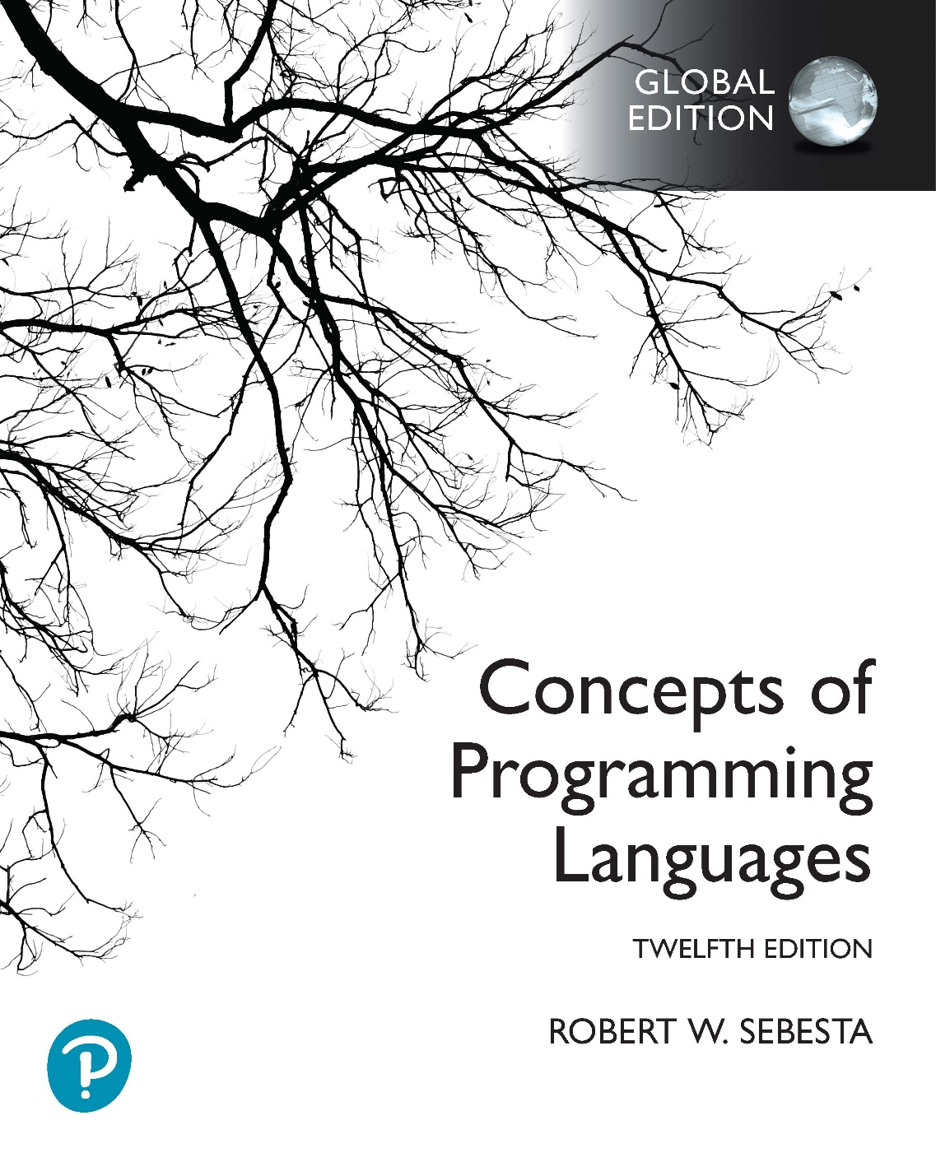
Chapter 15 Part 1
Functional Programming Languages

Slide 2
Chapter 15 Topics
Introduction
Mathematical Functions
Fundamentals of Functional Programming Languages
The First Functional Programming Language: LISP
Introduction to Scheme
Origins of Scheme
The Scheme Interpreter
Function Evaluation
Primitive Numeric Functions
Defining Functions
Output Functions

Slide 3
Introduction
Imperative language design is based directly on the von Neumann architecture
Efficiency is the primary concern
Suitability for software development is less important
The design of the functional languages is based on mathematical functions
A solid theoretical basis
Closer to the user
Unconcerned with machine architecture

Slide 4
Mathematical Functions
A function is a kind of subprogram
A collection of parameterized computations
Produce results by returning a value
Functional side effects
When a function changes a parameter or a global variable
Problem with functional side effects
When a function referenced in an expression alters another operand of the expression
For example
a = 10;
b = a + fun(&a);
What if fun changes the value of its parameter?
How does the same problem arise with global variables?
Notes:
Functional side effects and referential transparency are discussed in Section 7.2.2 of the textbook.

Slide 5
Mathematical Functions
Two possible solutions to the problem of side effects, both based on the language definition
Disallow functional side effects
No two-way parameters for functions
No non-local references in functions
Advantage
It works!
Disadvantage
Inflexibility of one-way parameters
Lack of non-local references
Demand fixed operand evaluation order
Java: Operands seem to be evaluated left to right
Disadvantage
Limits some compiler optimizations

Slide 6
Mathematical Functions
A program has referential transparency if
Any two expressions that are equivalent
Can be substituted for one another in the program
This does not affect the action of the program
One cause of referential transparency breakdown
Functional side effects
For example
If fun has no side effects, result1 = result2
If not, referential transparency is violated
How can referential transparency break in the example?
Can referential transparency break in other ways?
result1 = (fun(a) + b) / (fun(a) – a);
temp = fun(a);
result2 = (temp + b) / (temp – a);

Slide 7
Mathematical Functions
Advantage of referential transparency
Program semantics much easier to understand
Programs in pure functional languages
Do not have variables
Consider a function
Global variables can’t exist (so can’t be modified)
Parameter value must be constant (no variables)
This means there is no possibility of side effects
Functions cannot have state
State must be stored in variables
Value of the function depends only on parameters
Thus such languages are referentially transparent

Slide 8
Fundamentals of Functional Programming Languages
The objective of a functional language’s design
To mimic mathematical functions as closely as possible
The basic process of computation is fundamentally different in a FPL than in an imperative language
In an imperative language
Expressions are evaluated and the results are stored in variables for later use
Management of variables is a constant concern and a source of complexity for imperative programming
In a purely functional language
Variables are not used, as is the case in mathematics
We don’t need to worry about managing variables and the associated ambiguity

Slide 9
LISP Data Objects and Structures
Data object categories
LISP was originally a typeless language
Only atoms and lists
Two types of atoms
Symbols (identifiers like A and X)
Numeric literals (like 4.8 and 26)
List form
Sequences of atoms and/or sublists
Stored internally as single-linked lists
(A B (C D) E)
Notes:
Symbolic atoms are things like A and X. They don’t have an intrinsic meaning, and aren’t characters or strings. They were originally designed for AI applications to represent the idea of abstract concepts that AI programs could work with.
Numeric atoms are things like 4.8 and 26. We can perform arithmetic operations on them, like in an imperative language.
Both symbolic and numeric atoms can be stored in lists.
Note that atoms are handled in the same way in Scheme, and that the same list notation is also used in Scheme.

Slide 10
LISP Interpretation
Data and function applications have the same form
The list (A B C) interpreted as data
A simple list of 3 atoms, A, B, and C
The list (A B C) interpreted as a function application
The function named A is applied to two parameters, B and C
Function definitions
Lambda notation specifies function definitions
A lambda expression is a nameless function
(lambda(arg_1 … arg_n) expression))
We can bind a name to a lambda expression
(funct_name (lambda(arg_1 … arg_n) expression))
First LISP interpreter
Demonstrated universality of functional model
Universal LISP function can evaluate any other LISP function
Notes:
The term “name binding” in this case simply means that the name funct_name is associated with (or linked to) the lambda expression.
We will focus on Scheme, not LISP (I also won’t ask anything code-based on LISP). Scheme also allows names to be bound to lambda expressions, but uses the DEFINE function for this.
Don’t worry about the code example on this slide, but look at the DEFINE function on slide 13. The important thing to understand here is that a lambda expression is a function without a name, and that a name can be bound to a lambda expression.

Slide 11
Origins of Scheme
Scheme is a mid-1970s dialect of LISP
Designed to be a cleaner, more modern, and simpler version than contemporary LISP dialects
Scheme uses the same atoms and lists as LISP
Uses only static scoping
Scheme programs are built up of only functions
There are no operators or control structures
Functions are first-class entities
Expressions can evaluate to functions
They can be elements within lists
They can be passed as function parameters
They can be returned from functions

Slide 12
The Scheme Interpreter
A Scheme interpreter has an interactive mode
Operates in an infinite read-evaluate-print loop (REPL)
This form of interpreter is also used by Python and Ruby
Most interpreters accept source files, which are interpreted in a batch mode
Expressions are interpreted by the function eval
So the Scheme interpreter is actually a Scheme function!
Literals evaluate to themselves
Notes:
Scheme’s interactive mode simply allows you to type code in line by line via an interface (it might just be in a terminal, though), rather than writing a program in an editor. Generally Scheme implementations also allow you to write code using an editor, and then run the code using the interpreter. For your practical, you will use the second approach (writing code in an editor).
We’ll get back to eval in more detail a little later.

Slide 13
Function Evaluation
Function applications evaluated as follows
Parameters are evaluated, in no particular order
Values of parameters substituted into the function body
The function body is evaluated
The value of the last expression evaluated in the body is the value that the function defines
Notes:
Here “no particular order” means that there is an order of parameter evaluation implemented in a Scheme interpreter (this is required for the interpreter to work), but that the order is unimportant. Firstly, if the parameters are just values, the order they are handled in obviously doesn’t matter. But if the parameters are applications of functions (what you know as function calls) the order of evaluation is still unimportant. This is because, as we’ve seen before, functional languages have no functional side effects. This means that no parameter evaluation can affect any other parameter evaluation, and so the order the functions are evaluated in can’t affect the final outcome.
The last point on this slide is also important to remember.

Slide 14
Primitive Numeric Functions
Arithmetic operations
Remember that these are all functions!
Includes a set of primitive functions
‎+, -, *, /, abs, sqrt, remainder, min, and max
For example
The function application (+ 5 2) yields 7
All except abs, sqrt, and remainder can use multiple parameters
For example, (+ 5 2 8 9)
Notes:
Remember that everything in Scheme is a function. So +, -, *, and / are actually the names of functions that are provided by Scheme. Notice that their syntax is exactly the same as a normal function (function name first, followed by parameters).

Slide 15
Defining Functions
Lambda expressions
Form is based on lambda notation
For example:
‎(lambda (x) (* x x))
‎x is a bound variable: unchanged after 1st binding
Lambda expressions can be applied to parameters
For example
‎((lambda (x) (* x x)) 7)
‎x becomes bound to the value 7
The application of the lambda expression yields 49
Lambda expressions can have any number of parameters
‎(lambda (a b x) (+ (* a x x) (* b x)))
Notes:
We won’t be using the lambda function much (except on slide 32). This discussion is just to illustrate that nameless functions are possible. We usually define a function, and then bind it to a name using the define function (more on that in the next slides).
Note that x is not a variable in the sense you are used to. It behaves more like a constant.
In the first example, you should read it as “Define a lambda expression that has one parameter, and the result is the parameter multiplied by itself”. Note that there is no name for this function. This means that just providing the code (lambda(x) (* x x)) on its own isn’t useful, because the result is the nameless function and it is not used. There is no way to use this function after the lambda function has been applied like this, because we don’t have a name for it.
In the second example, we create the same nameless function as in the first example. We then take that function (again, it has no name, so we’re just taking the definition of the function) and apply it to the parameter 7. This means that the nameless function is now applied to the parameter 7, the parameter 7 is bound to (i.e. associated with) the name x, and the result of the function application is 7 multiplied by itself, which is 49. Note that the result of the lambda function application is the nameless function, not 49. The result of the application of the nameless function is 49.
The third example is just a more complex example of a nameless function. Again, this one is useless, because the nameless function isn’t used.

Slide 16
Defining Functions
Two general forms of define
To bind a name to the value of an expression
Examples
(define pi 3.141593)
(define two_pi (* 2 pi))
The binding can happen only once (unlike a variable)
To bind names to lambda expressions
For example
(define (square x) (* x x))
We can now use the name in a function application
(square 5)
The evaluation process for define is different!
First parameter is not evaluated as a normal function would
If it were evaluated, Scheme would find it was undefined
Copyright © 2023 Addison-Wesley. All rights reserved.
1-16
Notes:
As before, the term “binding” simply means an association (or linking). The first example under point 1 uses define to bind (or associate, or link) the name pi to the numeric literal 3.141593. From this point the symbol pi now “means” 3.141593. The second example under point 1 uses define to bind the name two_pi to the value of the expression (* 2 pi). The value of the expression (* 2 pi) is 6.28318, so from this point the symbol two_pi now “means” 6.28318.
The first example under point 2 uses define to bind the name “square” to the lambda expression (lambda (x) (* x x)). Note that we use an abbreviated form for the lambda expression, because we don’t have to explicitly use the lambda function within the define. It is actually possible to use the full lambda expression syntax within a define, but we won’t be doing this to make our programs more readable.
We will mostly be using define when we write functions. This means that we now have a name for the function, which we can use anywhere in our program. The define function is therefore useful on its own (as in the second example), unlike lambda in the first and third examples on the previous slide. You can think of define as achieving the same thing as a function declaration in a language like C++. However, also take note that define is a function itself, which simply performs a binding of a name to a lambda expression, so it is actually not the same thing as a function declaration.

Slide 17
Output Functions
To print an expression
(display expression)
To print a newline character
(newline)
Scheme also has a C-like printf
Generally, however, output functions aren’t used
Programs simply use the interpreter’s normal output
Any top-level (not nested) function result is printed
Explicit input and output are not part of pure FP
Input operations change the state of the program
Output operations are side effects
Notes:
Related to the last point: Of course, for a functional language to be useful we can’t avoid input and output. So even a “pure” functional language can’t entirely get away from side effects. In practise, however, input and output are fairly safe side effects.

